Slide 1


BRAIN TUMOR DETECTION
Guided By:-
Prof. Vidhi Pandya
Prof. Shraddha Vyas
Prepared By:- D19DCS155(Dhariya Parikh)
D19DCS157(Vatsal Singhala)
D19DCS155(Hardik Shiyani)
Semester:- 6
Branch:- CSE-2
Batch:- D
D19DCS159(Hardik Shi
MACHINE LEARNING

Slide 2
CONTENT
Introduction
Abstract
Requirement Gathering Techniques Used
Hardware and Software Requirements
Implementation Details
Snapshots
Limitations and Future Scope
Conclusion
References.

Slide 3
INTRODUCTION
Brain is most important party of our central nervous system.
Main task of doctors is to find Brain Tumor Which May be time consuming and feel burden.
The only solution for these problem is using Color segmentation using k-means clustering.

Slide 4
ABSTRACT
Brain Tumour Detection are challenging in medical image processing brain image is complicated.
Colour Segmentation plays a important role.
In these Project we will detect Brain Tumour Using color segmentation And K-Means clustering.

Slide 5
Requirement Gathering Techniques Used
One to One – We talked to some medical final year student and doctors about difficulty they faced during detecting Brain Tumour.
Research Papers-

Slide 6
Hardware and Software Requirements
Hardware Requirement:-
Processor : Core i3
Hard disk : 160 GB (Free)
Ram : 4GB
Software Requirement:-
Python
Jupyter Notebook

Slide 7
Implementation Details
We have used many libraries to develop
Opencv
Matplotlib
Numpy
joblib

Slide 8
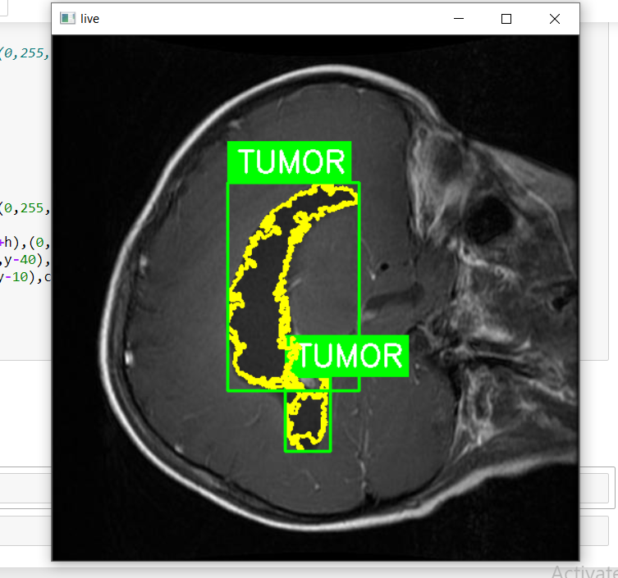
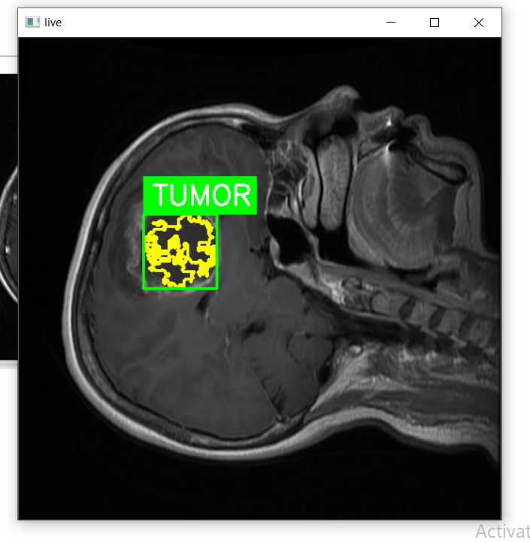
SNAPSHOT

Slide 9
Limitations and Future Scope
Limitations:-
We need more clear mri image.
Accuracy can be more improved
It cannot give exact length of tumor.
Future Scope:
We can implement user interface using tkinter which can make code more easy.
We can use more accurate algorithms in later versions

Slide 10
CONCLUSION
Here we conclude that we learn new technology while developing our project brain tumor detecting using K-means clustering and image segmentation

Slide 11
References
https://www.pyimagesearch.com/2015/02/02/just-open-sourced-personal-imutils-package-series-opencv-convenience-functions/
https://www.w3schools.com/python/numpy_intro.asp
https://docs.python.org/3/library/pickle.html
https://stackoverflow.com/questions/50473381/scikit-learns-labelbinarizer-vs-onehotencoder
https://www.tensorflow.org/api_docs/python/tf/keras/layers

Slide 12
THANKYOU

